Slide 1
Advanced pharmaceutical analysis lect. 1
5-stage
Mass spectrometry

Slide 2
* (MS) is super potent technique
- To give M.Wt
-molecular formula (HRMS)
- Elements represent
- structural information (fragmentation pattern)

Slide 3
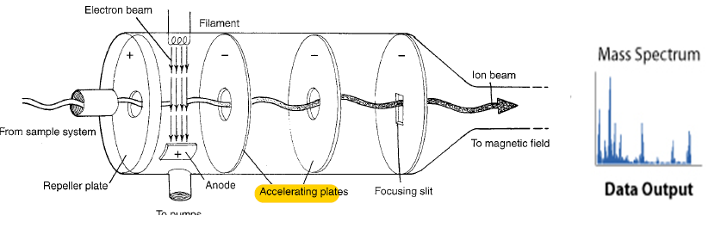
The mass spectrometer performs 3 essential functions:
1st it subjects molecules to bombardment by stream of high energy electrons, converting some of molecules to ions which accelerated in an electric field.
2nd ,the accelerated ions are separated according to their m/z ratio in a magnetic or electric field.
Finally, the ions that have a particular m/z ratio are detected ,amplified and recorder then give mass spectrum

Slide 4
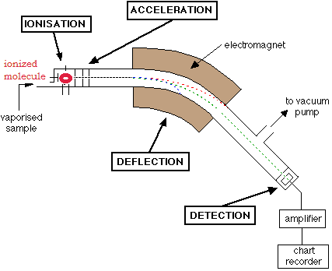
Basic principle: a charged particles moving in a magnetic field
*degree of deflection depends on mass/charge deflected less - heavier molecule more charged = deflected more -

Slide 5
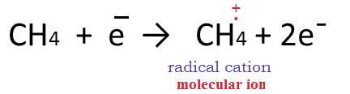
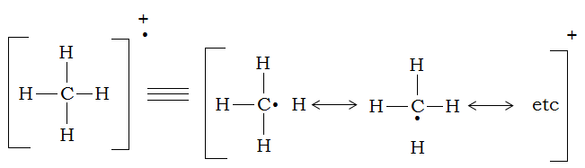
Electron Ionization (EIMS): the basic idea , use one electron to ionized the molecule
M + eˉ → M⁺ +2eˉ
- if you take CH4

Slide 6
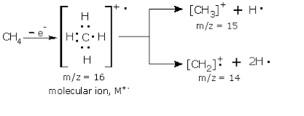

Slide 7
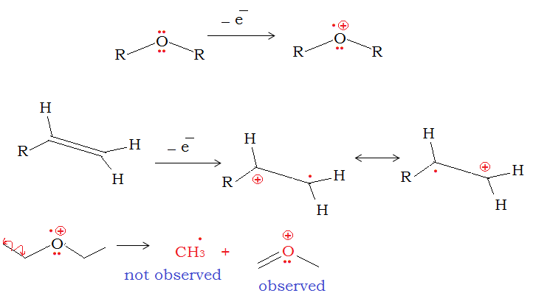
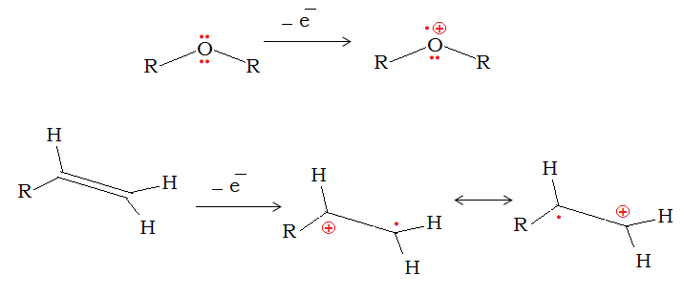

Slide 8
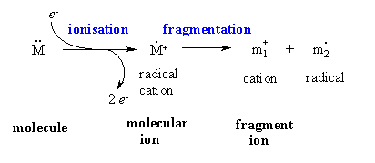
Probably the most useful information you should be able to obtain from a MS spectrum is the molecular weight of the sample.
• This will often be the heaviest ion observed from the sample provided this ion is stable enough to be observed

Slide 9
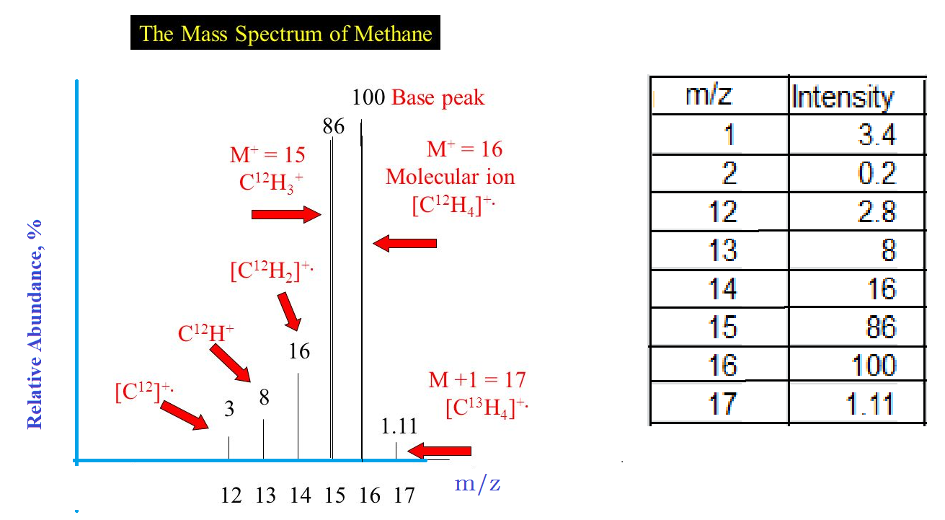
methane

Slide 10
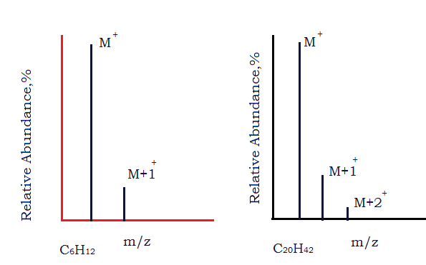
Isotopes
- most elements common to organic cpds r mixtures of isotopes.
- the existence of atomic isotopes in nature accounts for the appearance of M+1 and M+2 peaks in a mass spectrum.
- organic cpds containing only C,H,O and N usually have relatively small M+1 and M+2 Peaks.

Slide 11
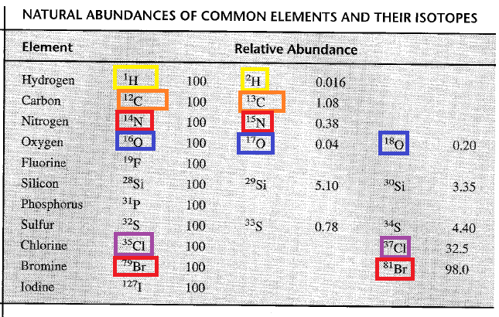

Slide 12
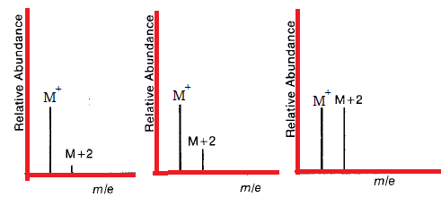
ISOTOPES:
MS is particularly valuable for cpds w contain Cl and Br:
- if one S atom is present,M+2 is ≈ 4% of M⁺
- if one Cl atom is present, M+2 is ≈ 33% of M⁺
- = = Br atom is present ,M+2 is ≈ to M⁺

Slide 13
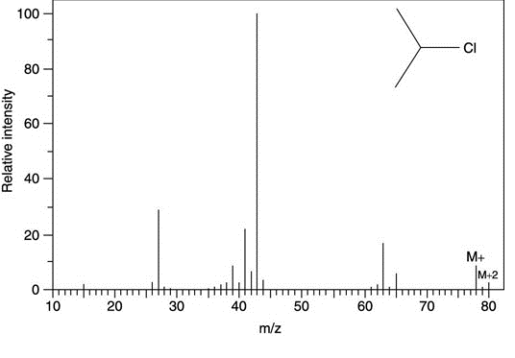
Mass spectrum with chlorine

Slide 14
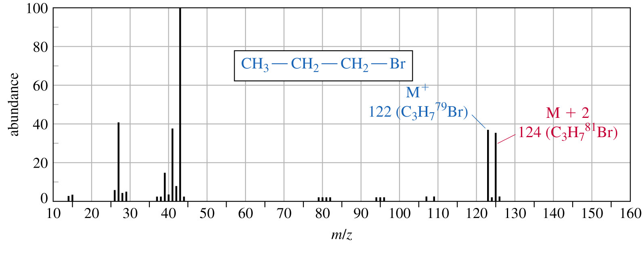

Slide 15
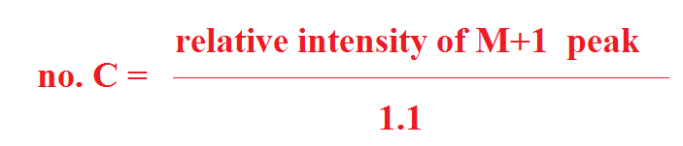
Carbone rule:
* for cpds containing only C,H and O the following formula can be used to determine the # C in the molecule:

Slide 16
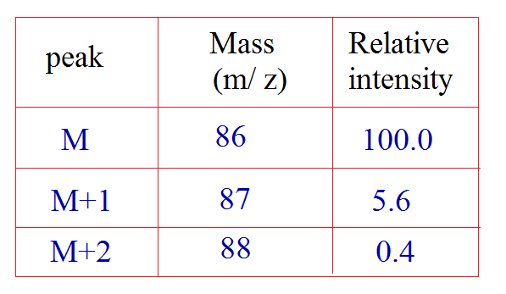
Can determine the molecular formula of unknown organic cpd whose mass spectral data is given in the table below:

Slide 17
Nitrogen rule:
- if a cpd with even # N(no N or even)= give even (M⁺) ,
- if cpd with odd # N= (M⁺) will be odd ex: C2H5NH2 M⁺= 45
H2NCH2CH2NH2 M⁺=60
(CH3)3CH M⁺=58

Slide 18
Resolution a measure of how well mass spectrometer separates ions of different mass.
҉ low resolution: capable of distinguishing among ions of different nominal mass,i.e, different by at least one or more amu.
҉ high resolution: capable of distinguishing among ions that differ in mass by as little as 0.0001 amu.
- for example:
All have a nominal mass of 28 amu CO, N2, CH2=CH2 high resolution MS can distinguish these molecules.
CO 27.9949 amu
N2 28.0061 amu
CH2=CH2 28.0314 amu

Slide 19
Fragmentation pathways:
- structural information is available from analysis of fragments formed by bond cleavages in molecular ion, M⁺ . - in general, M⁺ will fragment so as to form the most stable cationic fragment (carbocation)
- in some cases, M⁺ peak is very small or absent.

Slide 20
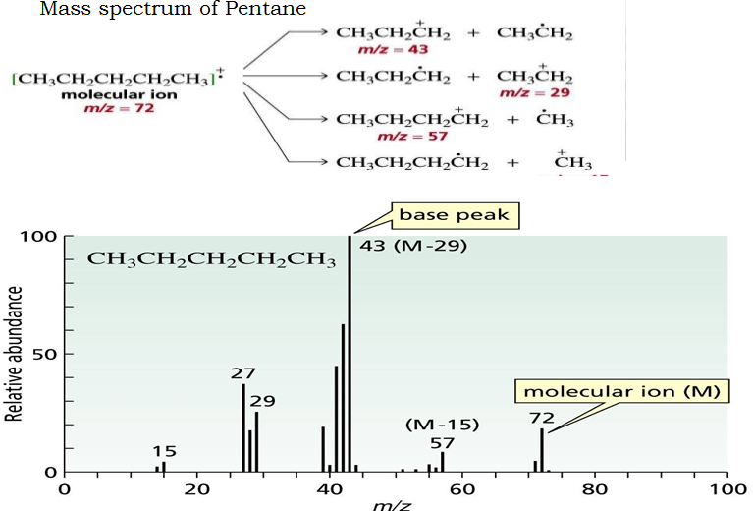

Slide 21

The most common mode of fragmentation involves the cleavage one bond, in this process , the odd-electron M⁺ yields an odd-electron neutral fragment and an even-electron fragment ion.
The neutral fragment that is lost is a radical, and the ionic fragment is of the carbocation type.
Cleavages which lead to formation of more stable carbocation are favored. thus,ease of fragmentation to form ions increases in the order.

Slide 22
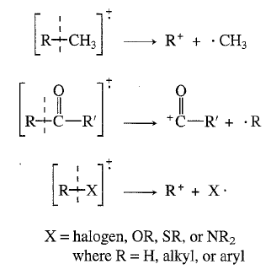

Slide 23
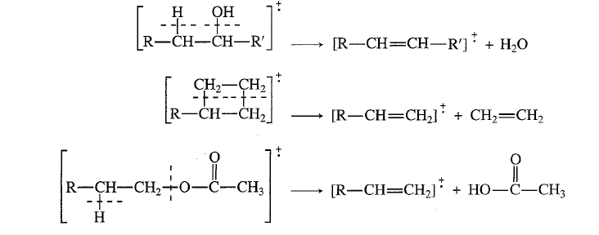
When cleavage of 2 bonds(most important type) odd-electron molecular ion (M⁺) yields an odd-electron fragment ion and an even- electron neutral fragment, usually a small molecule of some type ,for example:

